Slide 1
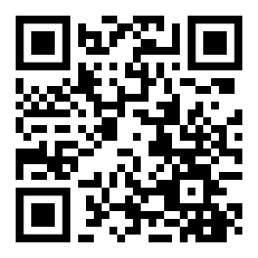
The Integration and Analysis of Data using Artificial Intelligence to Improve Patient Outcomes with Thoracic Diseases (DART)
You can help us improve the diagnosis of lung cancer
Your Lung Health Check is working with University of Oxford on a research project to use computers to detect lung cancer earlier and more reliably
Your role
Your data will be gathered during your lung health check or follow-on appointments.
Your data will be given a code, keeping it private but enabling an NHS research laboratory to link your health records, scans, biopsies and resections accurately.
Your data will be anonymised before it is used by researchers so there is no link back to you and you will never be identified in research or publications.
This study has been reviewed and approved by the West Midlands Black Country Research Ethics Committee, reference 21/WM/0278..
We have special permission to conduct the DART study without study-specific consent (i.e. link, transfer, process and analyse the data) from the Confidential Advisory Group under Section 251 of the National Health Service Act 2006 and its current regulations, the Health Service (Control of Patient Information Regulations 2002) (CAG reference number: 22/CAG/0010
Further information
If you want more information about the project ask here for a copy of the DART Information Sheet or visit www.dartlunghealth.co.uk.
If you do not want your data included in the project, please email ouh-tr.dart@nhs.net, tell us here or contact:
Poster v1.3 24.11.2022

