Slide 1
The Integration and Analysis of Data using Artificial Intelligence to Improve Patient Outcomes with Thoracic Diseases (DART)
Notes:
NB recording for minutes, will be deleted once minutes are completed

Slide 2
Agenda
Introductions
Governance
DART interdependencies and internal engagement (R&D department support and delegation; TLHCs, CT’s, pathology and blood).
Networking and technical support
Overview of pipeline (opening firewalls, PACS to PACS connection)
Open to discussion and any queries
Notes:
NB meeting will be recorded, recording will be saved for future reference.

Slide 3
Slido
Log in via slido.com with #4261340
By using this link https://app.sli.do/event/19VAm5uNL1umWDx4fnNeh6
Or by scanning the below QR code on your smartphone
Please complete the question in the poll
Feel free to use the Q&A section throughout the session.
All responses will be anonymous.

Slide 4
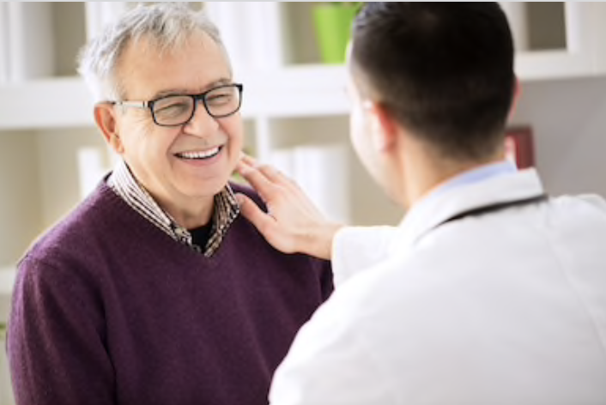
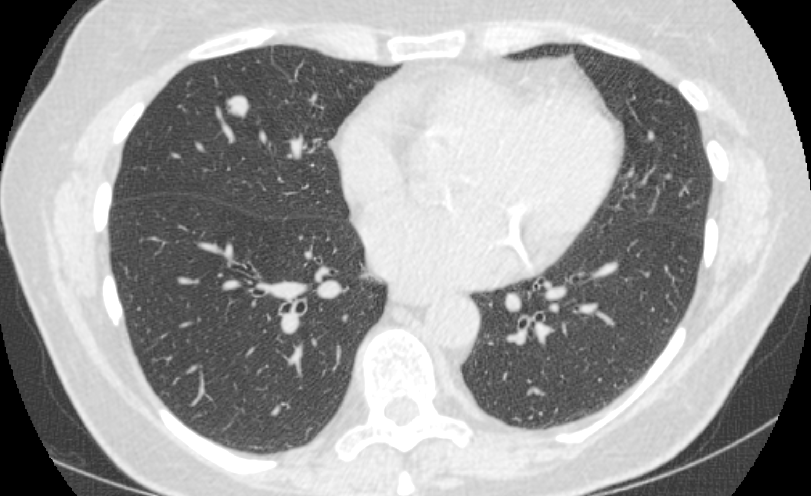
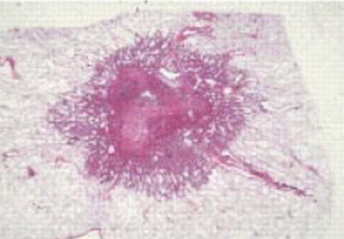
DART will capture and analyse data from LCS for improved integrated diagnostics
Notes:
The ambition of the study is to work with the data from the Lung Health Check centres and their partner hospitals, and use AI analysis of the patient metadata, CT images, digital pathology, and blood biomarkers to improve Lung Cancer Screening - by reducing the numbers of scans, removing the need for biopsies in LCS, and identify adverse factors in patients with cancers. All bar the blood biomarkers is data that can be collected retrospectively, and if we are successful will be the world’s largest AI LCS study, and hopefully show the NHS as a truly integrated care system at its best.

Slide 5
Reference numbers
Innovate UK 40255
IRAS 301420
CAG 22/CAG/0010
REC 21/WM/0278
Notes:
For your records

Slide 6
DART Local Site Processes
Local Governance Approval
Network set up
Email LHC spreadsheet
Transfer CT scans
Send Histology Slides
Done

Slide 7
DART responsibilities
Site Initiation Visit (SIV) by Teams
OID
Includes finance
Delegation log
Local Info Pack / Files for ISF
Poster and information sheets for display
Data transfer guidance document
Tech set up

Slide 8
Site responsibilities
Send completed version to DART
Delegation log
Capacity and Capability
OID
Follow local practices
DPIA
ISF
Display poster and information sheets
Invoice DART
Data transfer quarterly
Notes:
Store own DPIA (if required) and ISF

Slide 9
Network set up
OUH network details are:
IP: 10.134.128.213
AET: HDART1
Port: 10505
HSCN Peer IP: 10.134.250.98
Tunnel: IKEV2 and ideally AES 256

Slide 10
Images
Screening low dose CT and PET CT if called back
Transfer options
Direct PACS to PACS
DART team physically collect them on hard disk
Send to DART IEP
Notes:
We propose to collect the images in one of several ways.
(1) if you have a suitable PACS and networking it may be possible to automatically send copies of the LHC images to our research PACS in a steady stream
(2) a representative of the study will be driving around the country with a large, encrypted hard disk drive: they could visit each site and physically collect the images
(3) images could be sent to Oxford to our research PACS via Sectra IEP. We expect to be able to create IEP requests based upon the NHS England spreadsheets which you can respond to as you would any other trust-to-trust image transfer request. We have arranged for generous overtime payments for affected staff if this route is used.

Slide 11
Radiology reports
(For all images sent)
Extract relevant radiology reports for LHC participants from RIS
CSV needs both NHS and MRN to link with images and spreadsheets
Primarily looking for slice numbers for lesions – sequence important if bundling reports via IEP or sending directly
Notes:
For the reports, you will need to be able to
extract them from your RIS as a CSV
a representative of the study will be driving around the country with a large, encrypted hard disk drive: they could physically collect the reports
you could zip/encrypt the CSV and use NHS.net mail to the DART study team’s address
(4) (if your PACS and RIS talk to each other in the right way) attach them to the image before sending them to Oxford either directly or via IEP

Slide 12
TLHC spreadsheets
Complete TLHC spreadsheets
Quarterly or monthly email these to ouh-tr.DART@nhs.net
If sending images via IEP, we'll generate IEP requests from the NHS numbers in these spreadsheets
Notes:
Use NHSE TLHC spreadsheets (or similar if discussed with Steve Harris for DART
Email at regular intervals (as suit LHC) to secure NHS.NET email address
The CSV will need at minimum columns including the NHS number, MRN number, the image accession number, the imaging date, the report date and the report text itself. This will allow us to join the various sources together, and pick up any errors or inconsistencies.

Slide 13
Pathology slides
LHC patients need to be identified
H&E and Elastin slides – representative slides not all slides
Use for patient care first
Cover patient identifiers with label with pseudonymised case identifier
Ship quarterly to Oxford, wrapped in bubble wrap in padded envelope
Oxford THL will digitise and return slides to base hospital

Slide 14
Pathology reports
Extract finalised pathology reports for the slides' case
Include columns for patient NHS, MRN and the pseudonymised case identifier used on the slide
Include any Snomed coding if possible/available
Quarterly or monthly email these to ouh-tr.DART@nhs.net

Slide 15
Data received so far
78,359 clinical records (spreadsheets) from three sites
23,321 radiology reports from two sites
Pathology slides for digitisation from three sites for 239 patients
SCOOT blood samples from 63 patients
Two sites opened in past week

Slide 16
How can we support you?
Log in via slido.com with #4261340
By using this link https://app.sli.do/event/19VAm5uNL1umWDx4fnNeh6
Or by scanning the below QR code on your smartphone
Please complete the question in the poll
Feel free to use the Q&A section throughout the session.
All responses will be anonymous.
Notes:
Over to Gail to share screeen

Slide 17
Questions

