Slide 1
DART and SCOOT
CI: Fergus Gleeson (DART), Richard Lee (SCOOT)
Funder: Innovate UK
Sponsor: University of Oxford
DART: IRAS 301420, CAG 22/CAG/0010
SCOOT: IRAS 306757, REC 22/YH/0064, CPMS 52228

Slide 2
What are we trying to do?
Overall aim: Improve diagnosis of lung cancer
Diagnose lung cancer at an earlier stage when it is more treatable
Investigate whether blood biomarkers can help with this diagnosis
Find out if we can even diagnose which type of cancer and what treatment might work best
Also develop novel AI models to improve the care of all patients with Respiratory problems
DART&SCOOT_Intro_V1.0_31Jan2023

Slide 3
How are we trying to do this?
Developing quick, easy to use AI algorithms to diagnose lung cancer based on scan imaging, with and without blood biomarkers
We hope these will be quicker and more accurate than human assessment of scan imaging
Overall we hope this will reduce (and hopefully eliminate) the need for lung biopsies and other harmful invasive diagnostic procedures
And use all the information for the development of novel AI models
DART&SCOOT_Intro_V1.0_31Jan2023

Slide 4
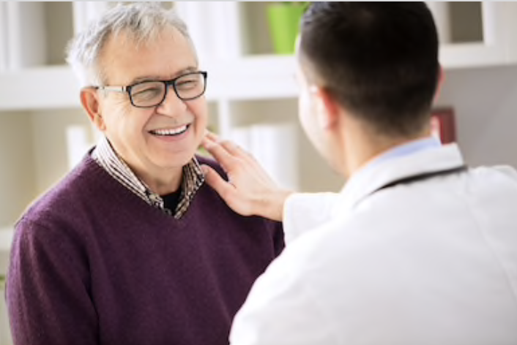
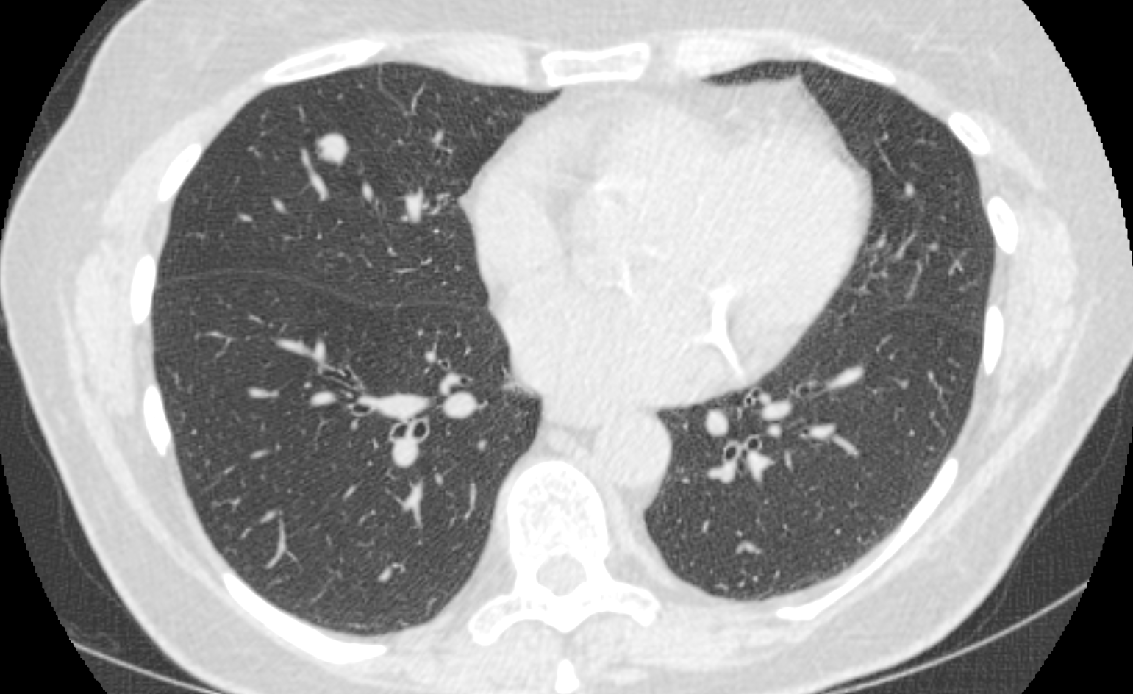
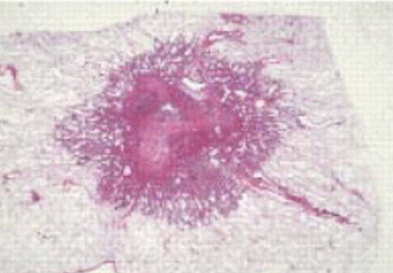
DART will capture & analyse data from LCS for improved integrated diagnostics
Notes:
DART is a secure server within Oxford University Hospital NHSFT’s established data infrastructure to collect and transfer:
clinical data
CT scans (LDCT and PET-CT) and
digitised images of stained tissue sections (digital pathology)
from participants of the lung cancer screening programme to University of Oxford, under CAG Section 251. Blood-derived data from consented patients is also being used.
This is the first time these diverse data types have been integrated using Artificial Intelligence algorithms to enable further and improved characterisation of disease than is possible by a radiologist alone.
DART aims to generate disruptive integrated diagnostic innovations that:
(1) more accurately diagnose lung cancer with enhanced prognostic information;
(2) reduce the occurrence of harmful invasive procedures in the diagnostic pathway;
(3) improve patient selection for lung cancer screening and reduce costs;
(4) improve assessment of risks from comorbidities; such as chronic obstructive pulmonary disease (COPD)
(5) improve patient outcomes
(6) generate and store a large amount of data that can be used for future research in a “data lake”.

Slide 5
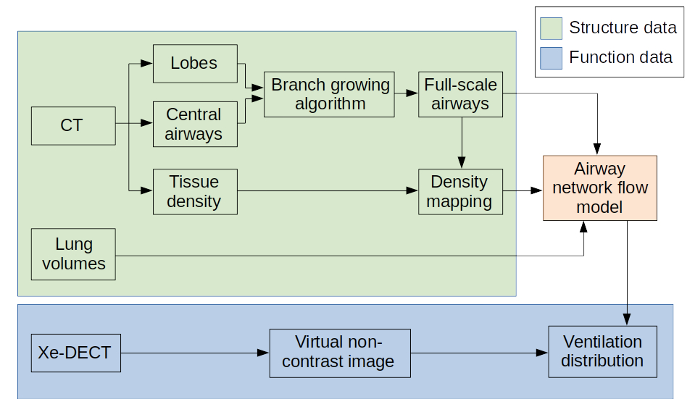
Development of AI COPD model
Lung Function data
Lobe surface, large airway geometries were segmented from CT images
Small airways were generated with a branch growing algorithm
Pulmonary tissue density from CT and lung function data were applied to the boundary conditions of the model
Notes:
Diagram: FAN model uses the structural data from images (green shade) to simulate the flow (red shadow) and assess lung ventilation (blue shadow)
Movie: This FAN model demonstrates the gas wash-in and -out simulation in 76 year old man with COPD.

Slide 6
Which patients can be included in DART?
All those attending a Targeted Lung Health Check
NHSE opt out will be applied by DART (checks run daily)
CAG support for transfer of identifiable data to secure OUH NHSFT server and email address (22/CAG/0010)
Data is de-identified before use in research

Slide 7
DART data transfer requires the following…
Research activity | Who will do this? | Help we offer
Network set up | PACS/networking team | Guidance document 60 minute meeting to set up
Display poster and information sheets | TLHC manager | CAG approved patient information sheets for display
Copies of TLHC spreadsheets emailed to ouh.tr-dart@NHS.NET | TLHC manager | Secure NHS email address
CT scans | PACS manager | VPN set up so process is totally automated
Radiology reports (for CT patients) | PACS manager | VPN
Representative H&E and Elastin slides posted to Oxford THL | Path Lab manager | Manual DART can provided list of NHS numbers if necessary
Pathology reports emailed to ouh.tr-dart@nhs.net | Path Lab manager

Slide 8
Who is eligible to participate in SCOOT?
Patients with a pulmonary nodule(s) detected on a CT scan performed as part of TLHC which requires further investigation with a PET-CT scan, and/or biopsy, and/or surgical resection
Willing and able to give informed consent
When can we consent/collect the sample?
At any LHC-related appointment after the initial low-dose CT scan has revealed a nodule requiring further investigation.

Slide 9
Where does SCOOT fit in to the LHC pathway?

Slide 10
SCOOT requires the following…
Research activity | Who will do this? | Help we offer
PIS given to patient | Research team during appointment/mailed in advance
Consent obtained | Any appropriately trained staff member (does not have to be RN or Dr) | CPMS accruals
Blood sample collected | Research team/phlebotomist | Per patient payment
Blood sample processed | Research team/lab team | Per patient sample kit provided by SCOOT team Centrifuges available for loan during study
Frozen samples shipped | Research team/lab team | Paid for and organised by SCOOT team

Slide 11
Current status
Timelines:
SCOOT is recruiting until end of December 2023
The projects are currently running in:
DART | SCOOT
Gateshead | Kettering
Kettering | Liverpool
Liverpool | Newcastle
Newcastle
RM Partners
Stoke

Slide 12
Contact info Any questions, please get in touch!
DART study team:
Project Manager: Anne Powell
anne.powell@oncology.ox.ac.uk
SCOOT study team:
Trial Manager: Rachel Austin
octo-scoot@oncology.ox.ac.uk

